Slide 1


Prepared by: Advisor: Prof. Dr. Ahmet Cevdet YALÇINER
İSKENDERUN ZEN PORT COMPLEX

Slide 2
OUTLINE
PROJECT DESCRIPTION AND SCOPE
PROJECT LAYOUT AND COMPONENTS
CONSTRUCTION LOCATION
REQUIREMENT ANALYSIS
MAJOR CONSTRUCTION PROCESS
WORKING PRINCIPLE OF COMMERCIAL PORT COMPLEX
DESIGN CONSIDERATIONS

Slide 3
DESIGN COMPONENTS
3 stages
1. Scoping and Optimization
2.Preliminary Engineering Design
3. Detailed Design

Slide 4
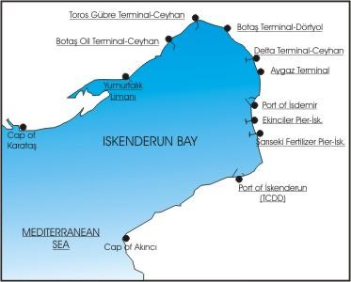
PROJECT DESCRIPTION AND SCOPE
The northeast of the Mediterranean Sea.
increasing need for a new and larger scale commercial port.
The scope of the Project includes coastal, geotechnical and structural details
The cost: 600 million dollars
Figure 1: Gulf of iskenderun

Slide 5
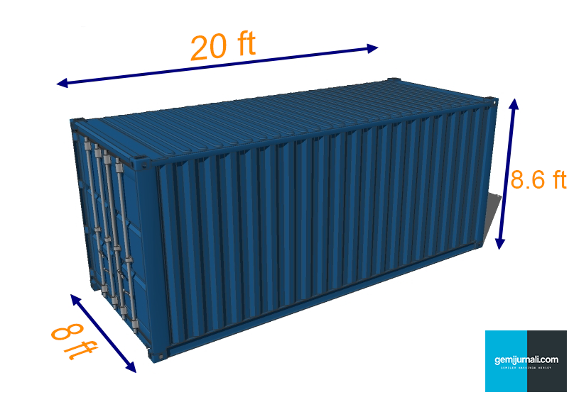
1.5 million TEU (twenty-foot equivalent unit)
1370 m in the seaward direction 460 m in the other direction.
Total area of 630200 m².
8 dock cranes 50 field cranes
Figure 2: Dimensions of TEU

Slide 6
LIMITATIONS
Max 350 m long ships
Max depth from water level 15m
Max depth for port 23 m
1.500.000 container per year.

Slide 7
Project Layout & Components

Slide 8
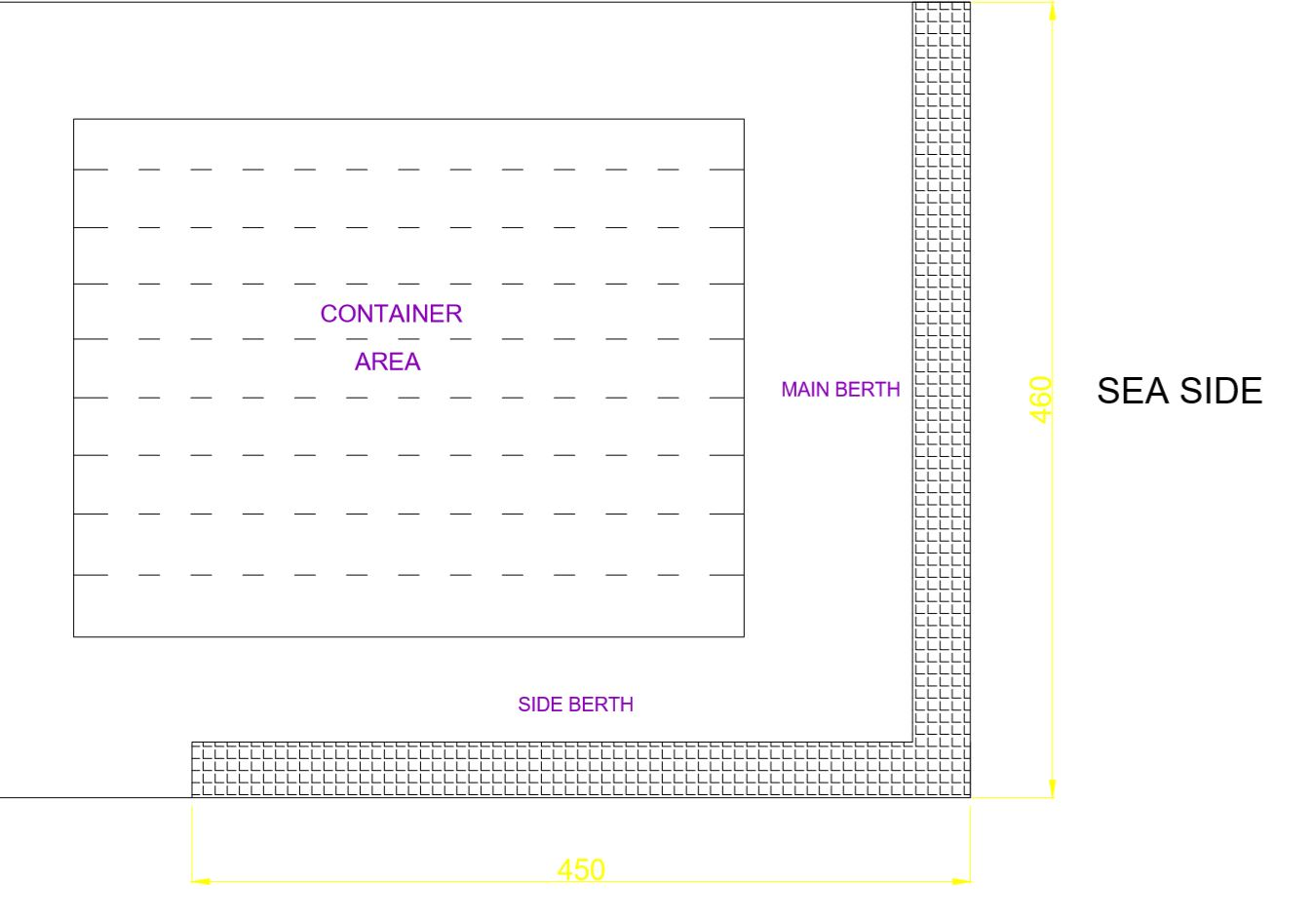
Berth
Figure 3: Berth Structure

Slide 9
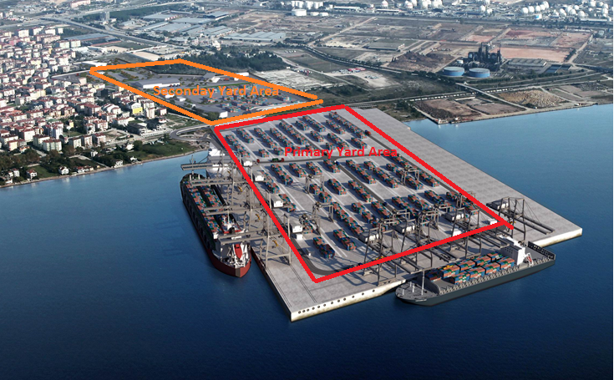
Yard Area
Figure 4: Yard Areas

Slide 10
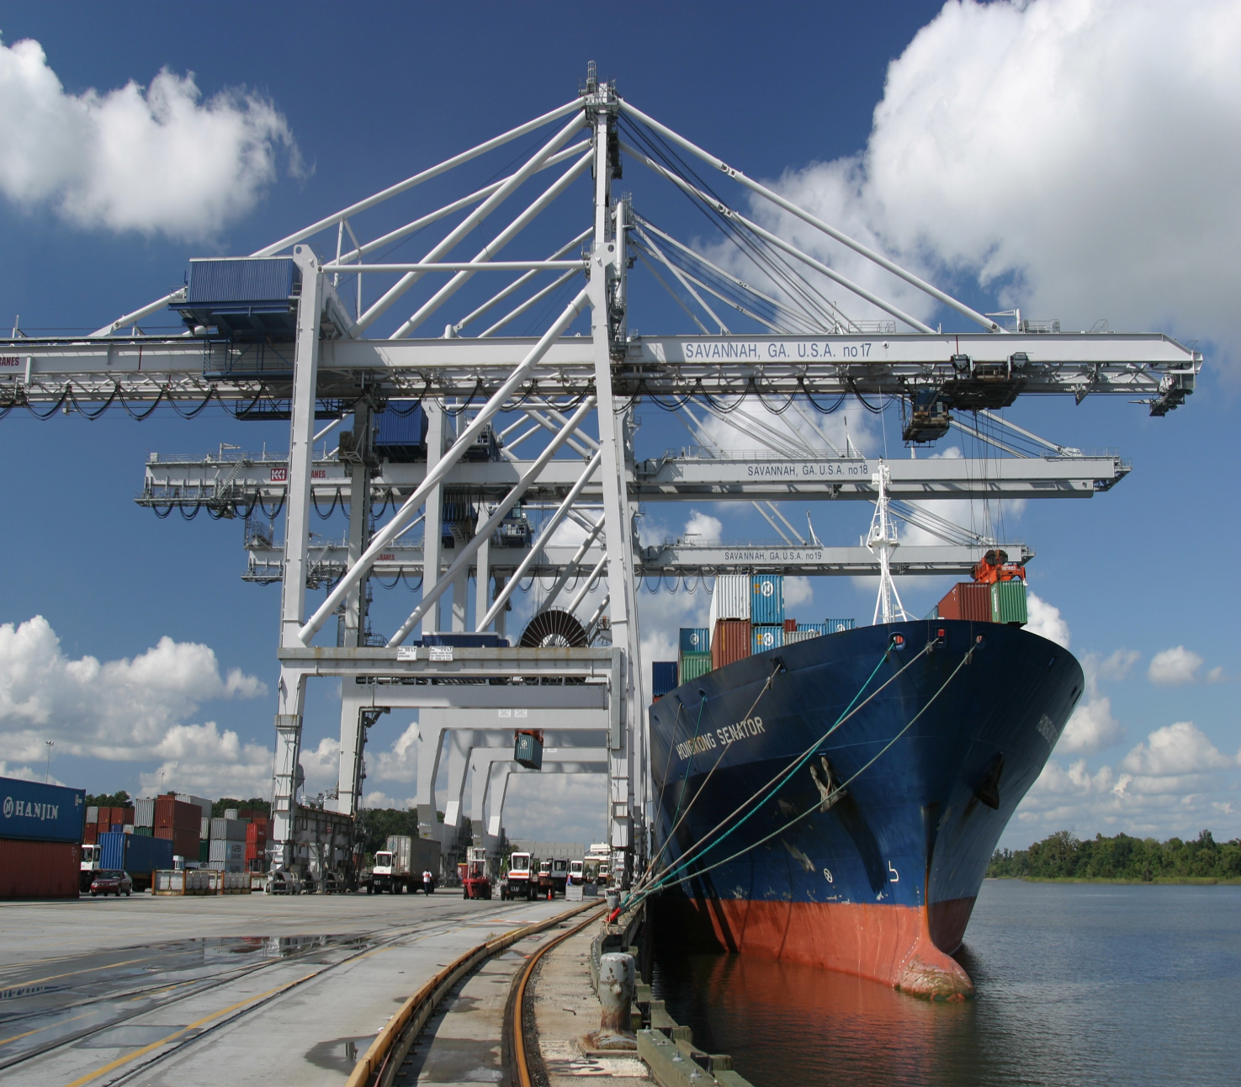
Apron
Figure 5: Typical Apron

Slide 11
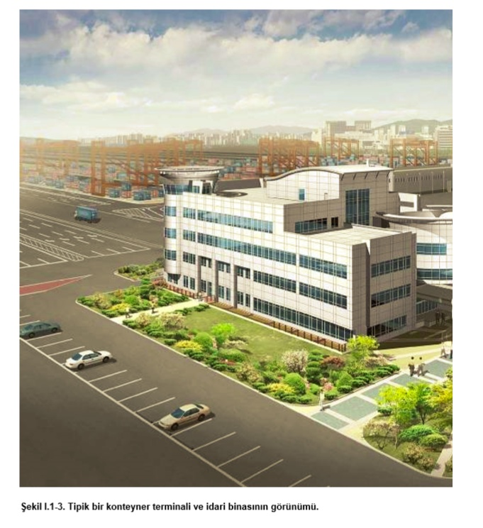
Admistrative Building
Figure 6: Typical Administrative Building

Slide 12
Buildings in the Project:
Administrative Building
Social Building
Workshop Building
Cargo Handling Building
Custom House
Transformer
Entrance and Exit Building
Operation Building
Fire Engine Building
 | Number of Storey | Height (m)
Administrative Building | 2 | 7.5
Social Building | 1 | 4
Workshop Building | 2 | 12
Cargo Handling Building | 1 | 4
Custom House | 1 | 4
Power Distribution Unit (Transformer) | 1 | 2.5
Entrance and Exit Building | 1 | 4
Operation Building | 1 | 4
Fire Engine Building | 1 | 2.5
Figure 7: Planned Number of Storeys and Heights

Slide 13
Container Freight Station ( CFS )
Vehicle and Container Wasging Area
Car Parking Lot
Security
Gas Station
Trailer Parking Lot ( 150 Trailer Capacity )

Slide 14
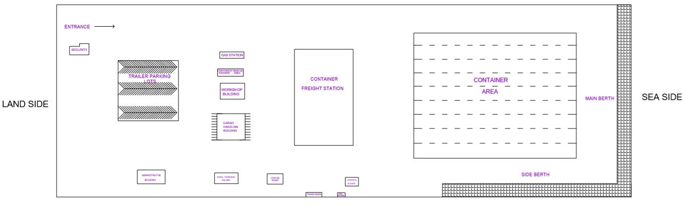
Project Plan
Figure 8: Area of buildings and some places
Figure 9: Plan of the Project

Slide 15
CONSTRUCTION LOCATION
at The Gulf of Iskenderun
The coordinates of the port are 36^{ο}48’48.51 N and 35^{ο}52’14.38 E.
near Sugozu Thermal Power plant and is located in the vicinity of Sugozu County (Yumurtalik).

Slide 16
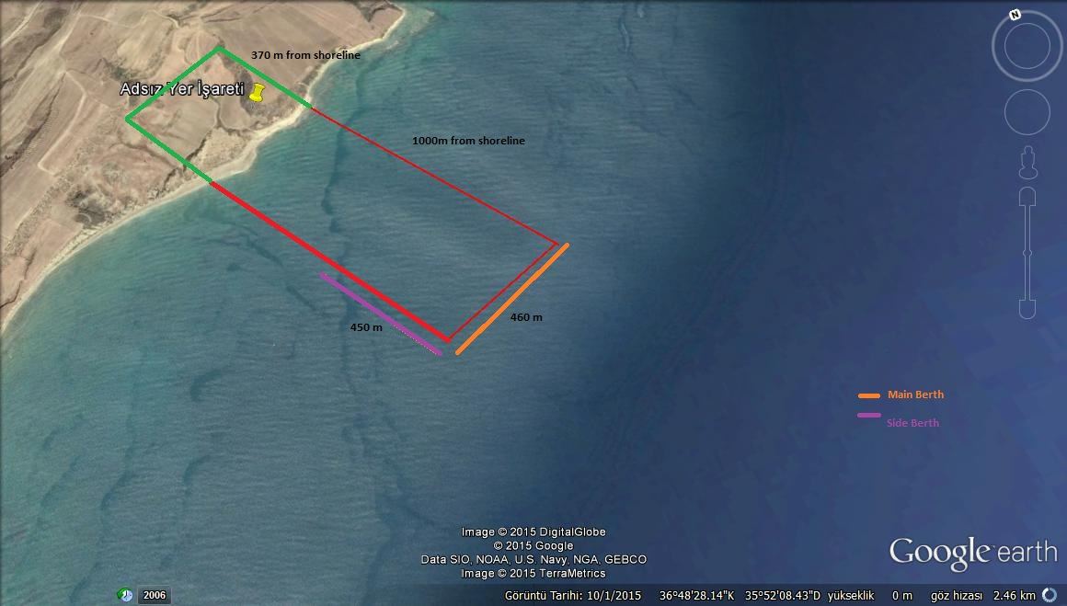
Figure 10: The exact location of Iskenderun Zen Port Complex

Slide 17
Seabed Profile (Bathymetry)
the underwater equivalent to hypsometry or topography.
In order to determine the required fill amount and pile heights
Figure 11: Batymetry of Gulf of Iskenderun

Slide 18
REQUIREMENT ANALYSIS
The Need and the Importance of Zen Iskenderun Port Project
It has been estimated that around 90 per cent of the world’s merchandize and commodity trade is transported by ship
Rapid growth in the ship transportation in Turkey and the World

Slide 19
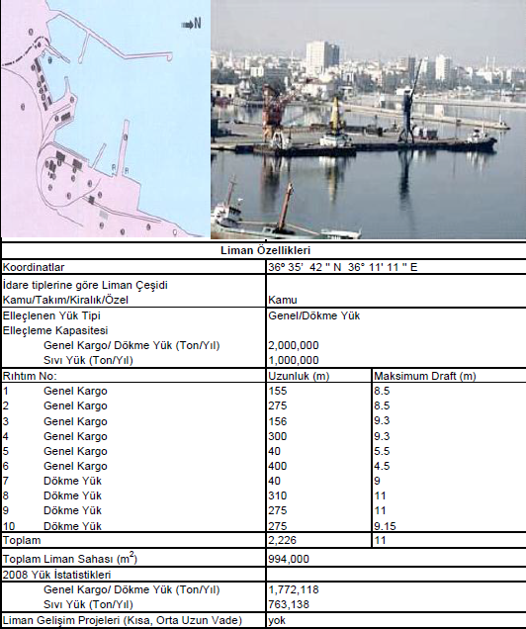
Other Ports in the region and Their Characteristics
Port of Iskenderun
Figure 12: Characteristics of port of Iskenderun

Slide 20
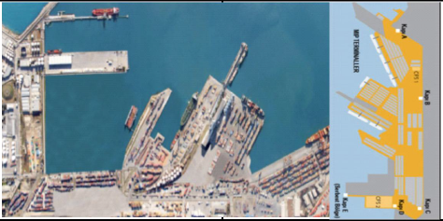
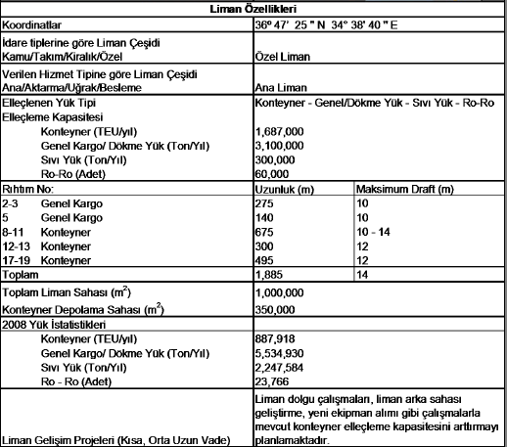
Port of Mersin
Figure 13: Characteristics of Port of Mersin

Slide 21
MAJOR CONSTRUCTION PROCESSES

Slide 22
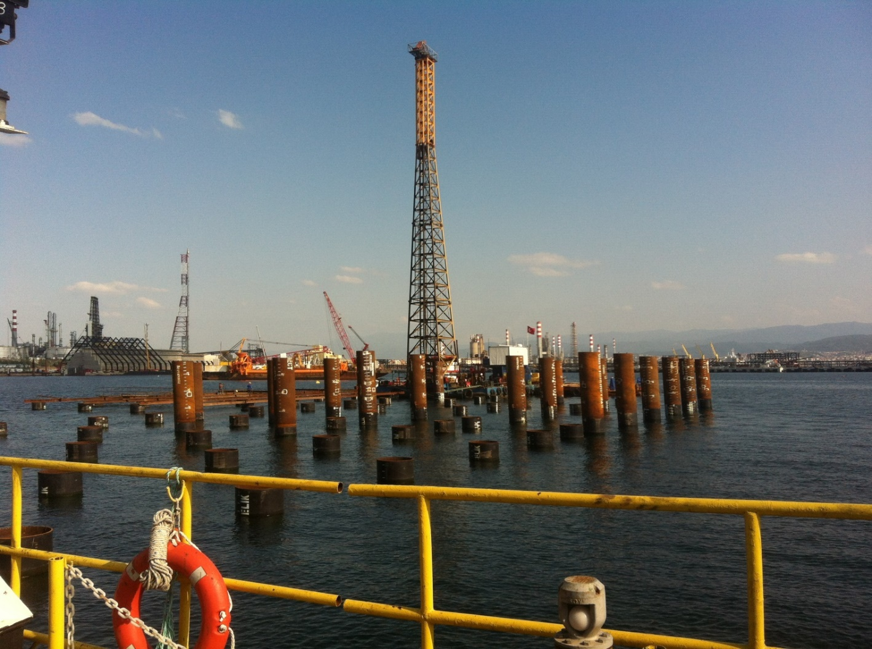
PILING
Wooden
Steel
Concrete
etc.
Figure 14: An example of piling

Slide 23
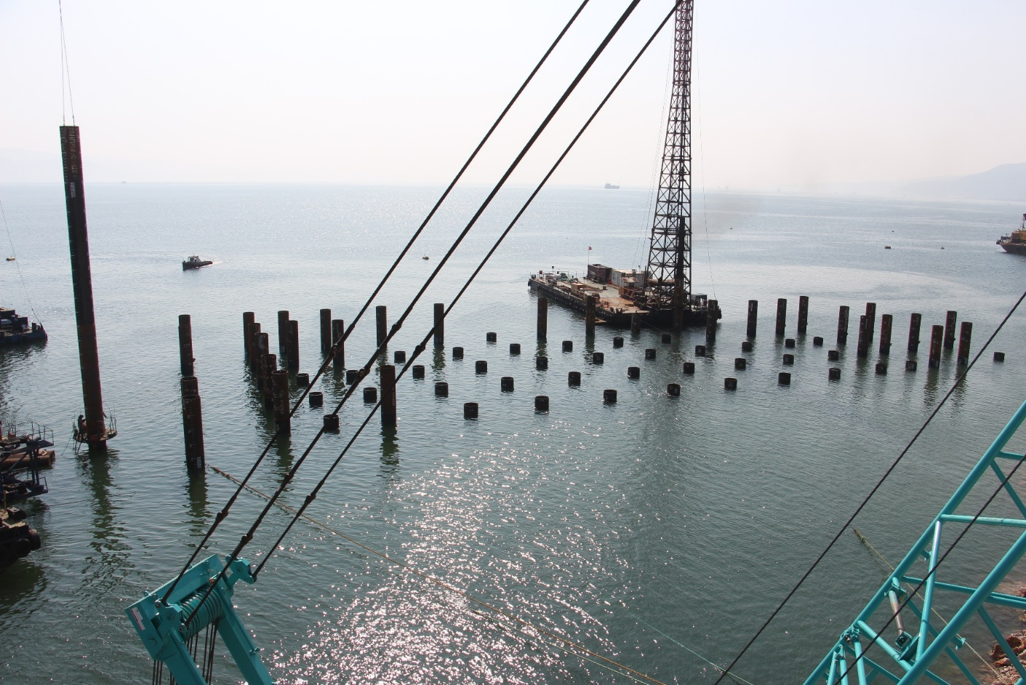
STEEL PILING
Corrosion
Coating
Figure 15: Steel Piling

Slide 24
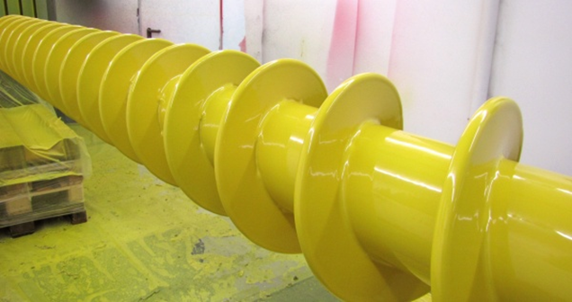
COATING
Epoxy
Figure 16: Epoxy

Slide 25
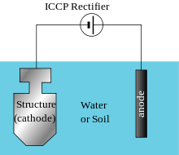
CATHODIC PROTECTION (CP)
Sacrificial metal = Anode
Protected structure = Cathode
Figure 17: Cathodic Protection

Slide 26
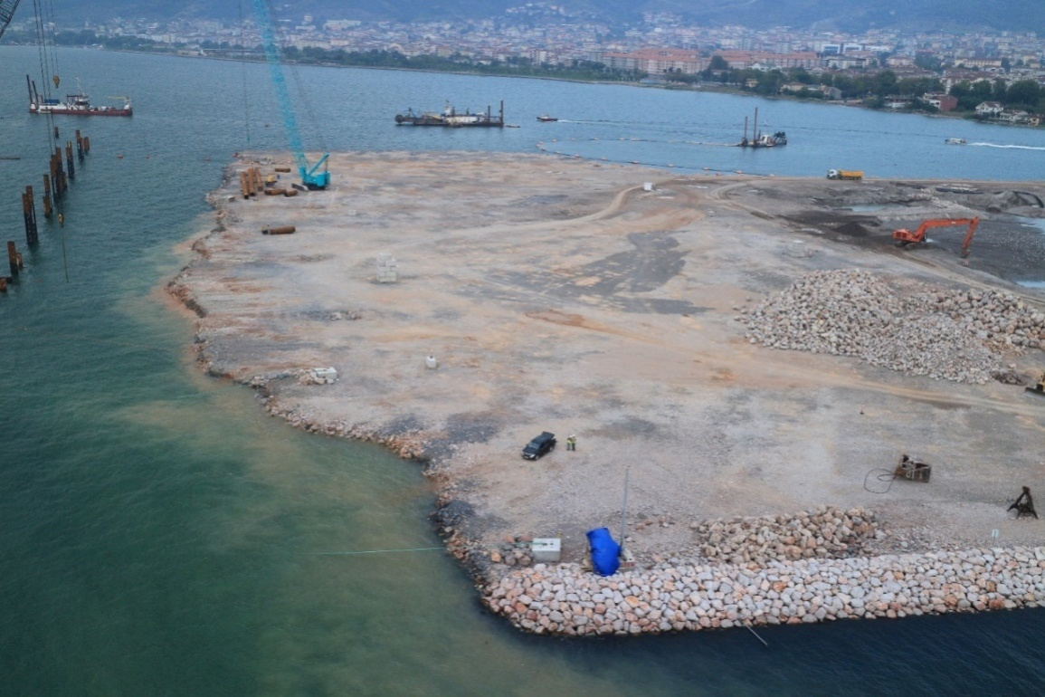
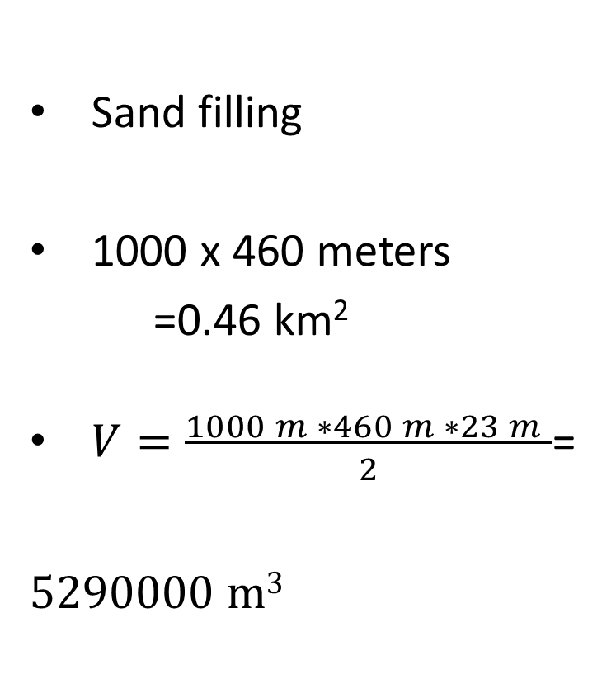
BACKFILLING
Sand filling
1000 x 460 meters
=0.46 km²
$V=\frac{\begin{aligned} \\ 1000 m ∗460 m ∗23 m \end{aligned}}{2}$=
5290000 m³
Figure 18: Backfilling

Slide 27
WORKING PRINCIPLE OF COMMERCIAL PORT COMPLEX

Slide 28
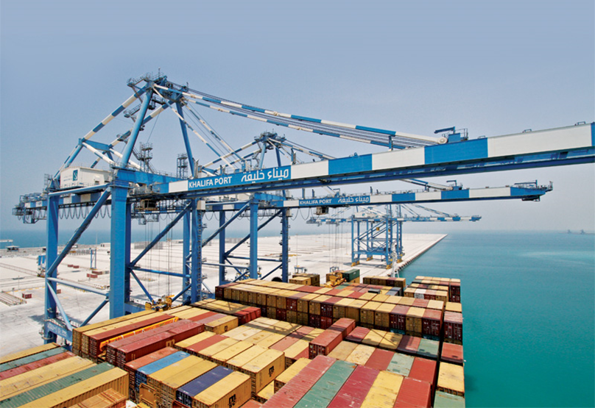
Cargo handling equipment
(cranes, forklifts)
Figure 19: Example of a Crane

Slide 29
DESIGN CONSIDERATIONS
Near shore Current System
Wind and Wave Climate Studies
Wave Transformation Studies

Slide 30
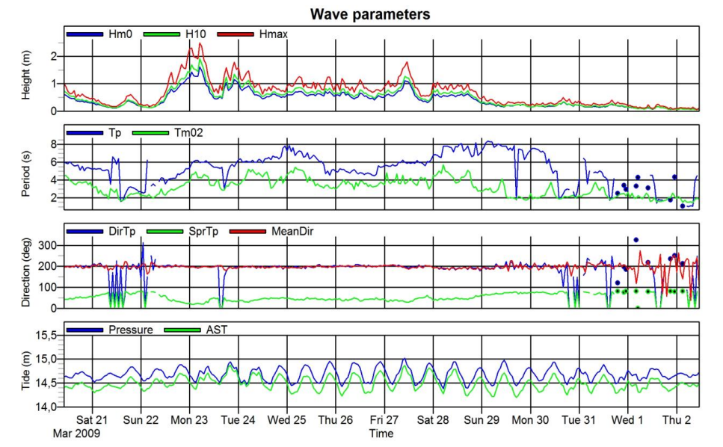
Wave parameters
Figure 20
Figure 20: Wave parameter measurements

Slide 31
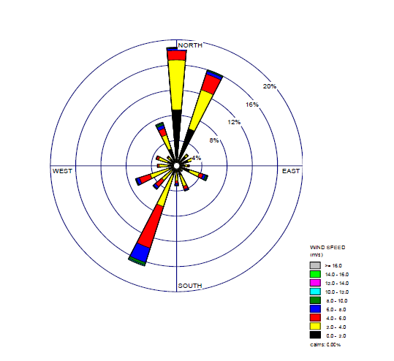
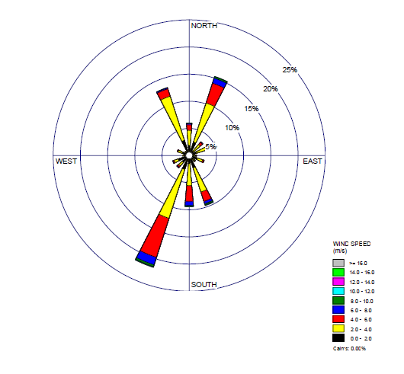
Annual Wind Rose of the Region
Figure 21: Karatas Meteorological Station Wind Rose
Figure 22: Yumurtalik Meteorological Station Wind Rose

Slide 32
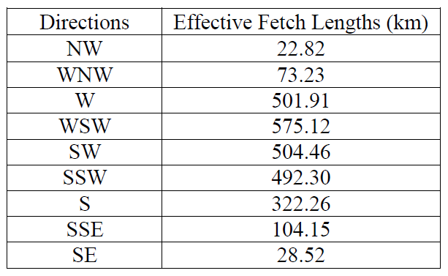
Effective Fetch Study
Figure 23: Study at the Entrance of Iskenderun Bay (7.5° slices)

Slide 33
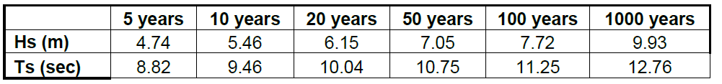
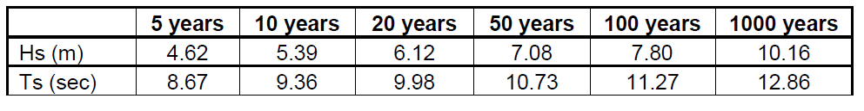
Extreme Wave Statics Results
Karatas Meteorological Station;
Yumurtalik Meteorological Station;

Slide 34
Refraction of water waves is the adjustment in the direction of a wave moving in shallow water at an angle to the contours.
Shoaling of water waves is caused by the fact that the group velocity changes with water depth.

Slide 35
References
Port of Iskenderun. (2012, December 1). Retrieved November 15, 2015, from http://www.tilgroup.com/terminal/port-iskenderun
Port of Iskenderun. (n.d.). Retrieved November 15, 2015, from http://www.marinetraffic.com/ais/details/ports/1686/Turkey_port:ISKENDERUN
Material Durability in Coastal Environments. (n.d.). Retrieved November 15, 2015, from http://www.fema.gov/media-library-data/20130726-1510-20490-7873/07_ccm_res_material_durability.pdf
Final report of master plans of transportation buildings (2010,September). Retrieved November 24,2015, from http://yalciner.ce.metu.edu.tr/ce410/Ulastirma-yapilari-master-plan-sonuc-raporu.pdf
Impreglon UK - HVOF, Plasma, Metal Spray and Energy Absorption Coating Applicator. (n.d.). Retrieved November 15, 2015, from http://www.power-technology.com/contractors/cathodic/impreglon-uk/impreglon-uk2.html
ORNEK ARA RAPOR ISKENDRUN BAY. (n.d.). Retrieved November 15, 2015, from http://yalciner.ce.metu.edu.tr/courses/ce410/RAPOR-1-Iskendrun-bolgesi-su-duzeyi-degisimleri.pdf
Wind and Wave Climate Studies. (n.d.). Retrieved November 15, 2015, from http://yalciner.ce.metu.edu.tr/courses/ce410/RAPOR-2-wind_deep-watwer-wave_statistics.pdf
Wave Transformation Studies. (n.d.). Retrieved November 15, 2015, from http://yalciner.ce.metu.edu.tr/courses/ce410/RAPOR-2-wind_deep-watwer-wave_statistics.pdfhttp://yalciner.ce.metu.edu.tr/courses/ce410/RAPOR-3-wave_transformation_report-iskenderun-bay.pdf

